Slide 1



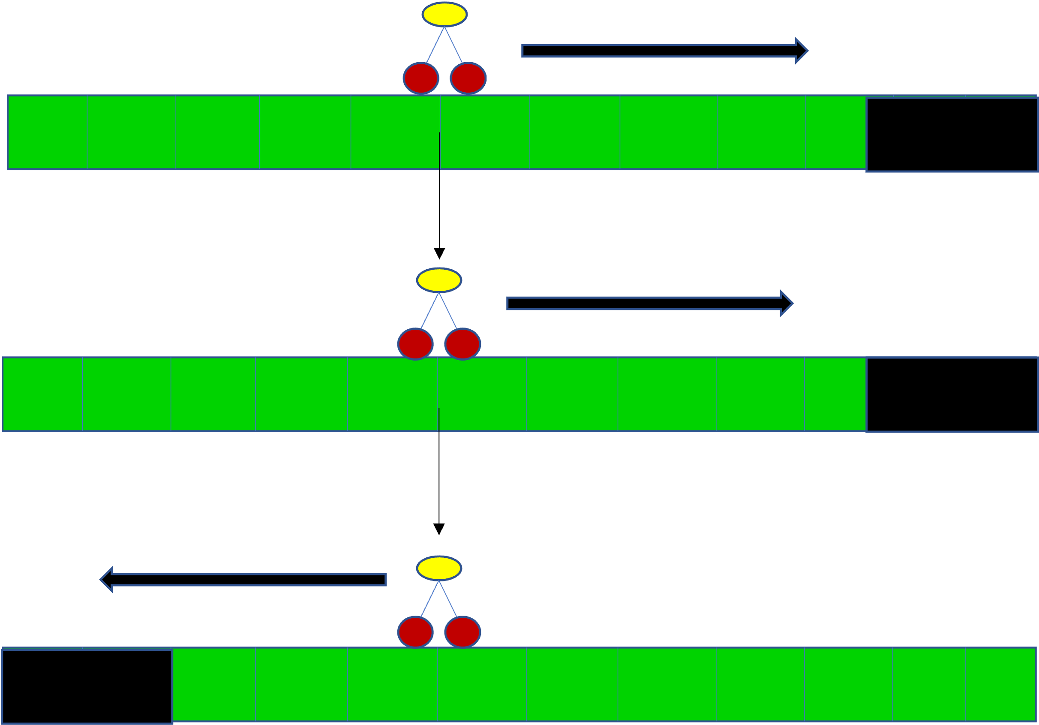
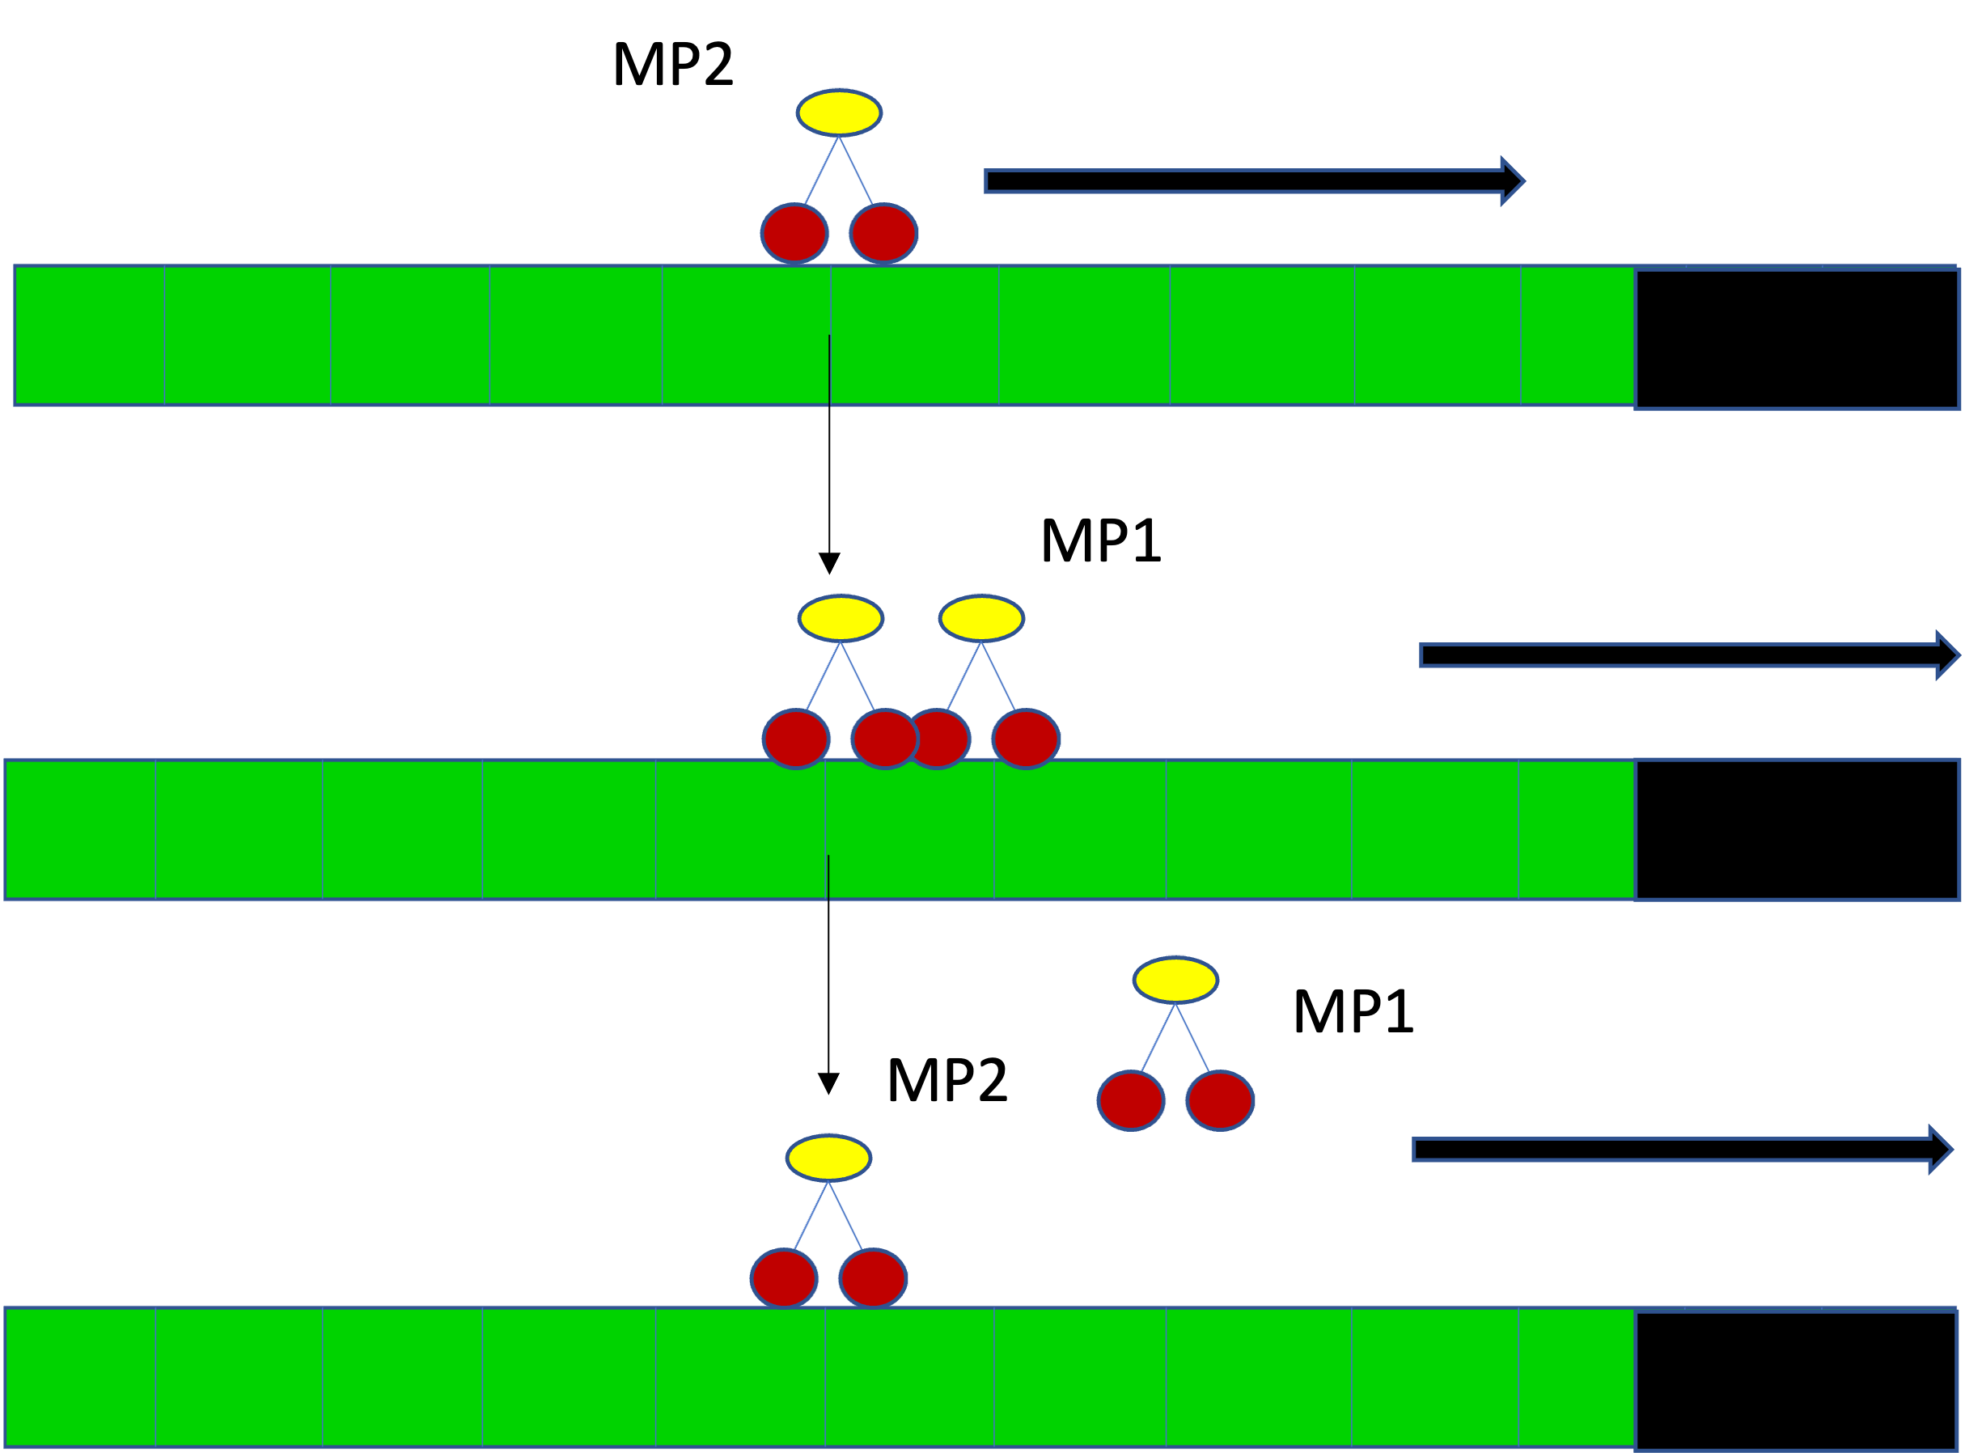
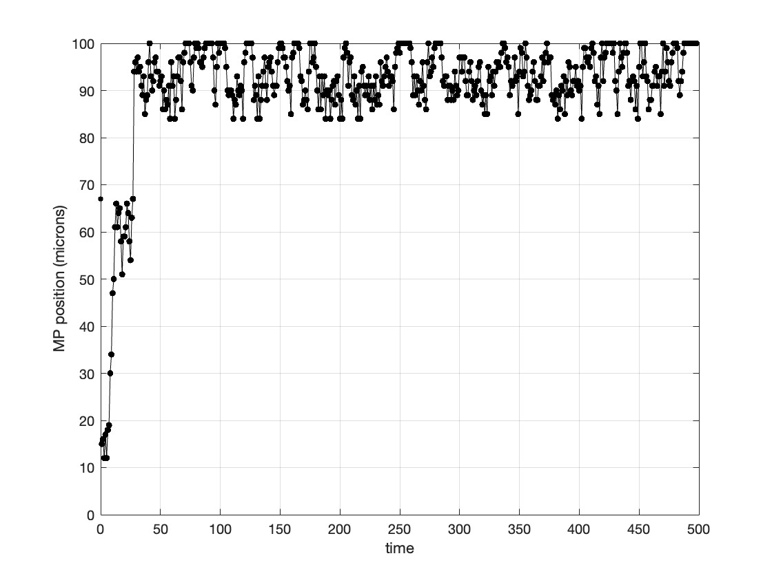
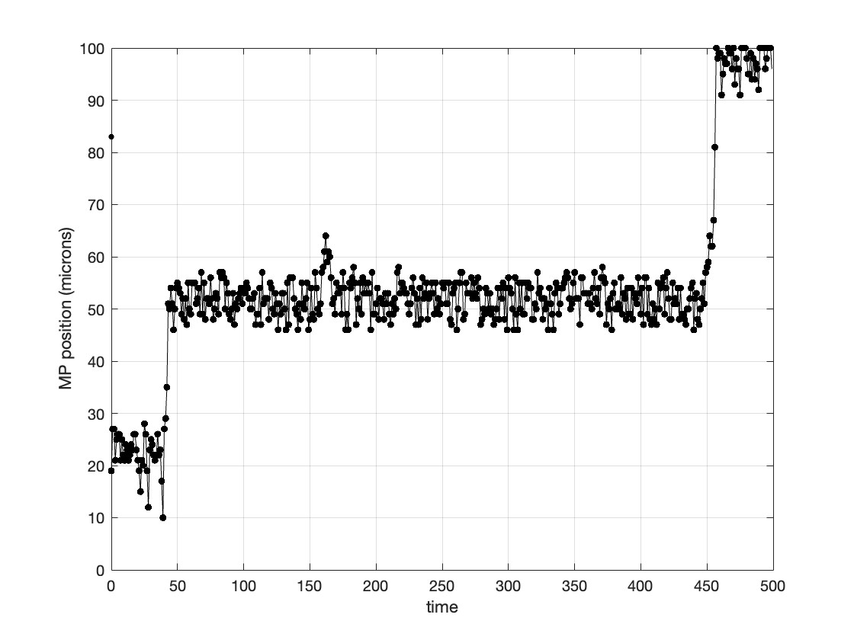
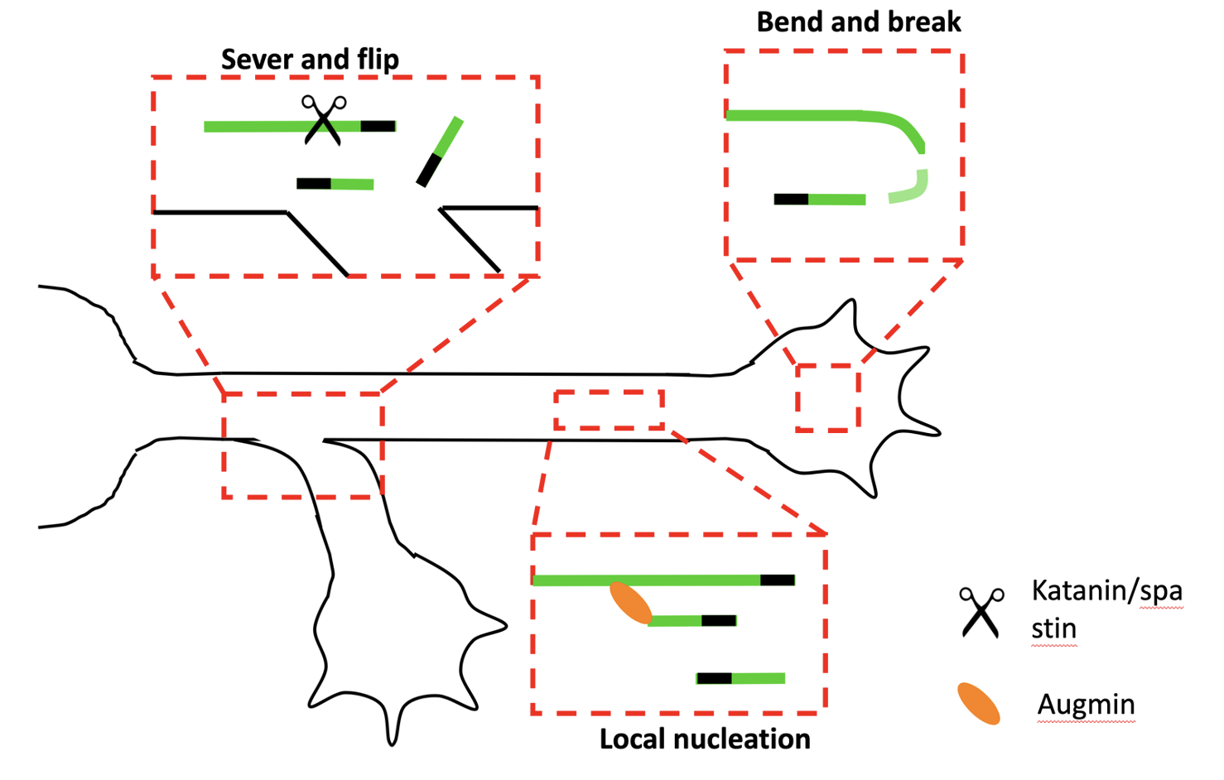
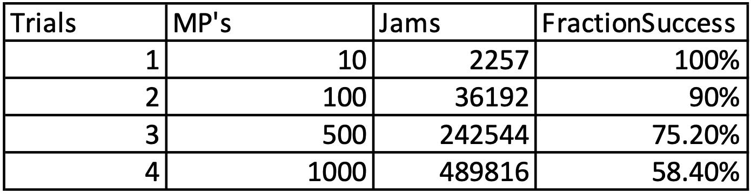
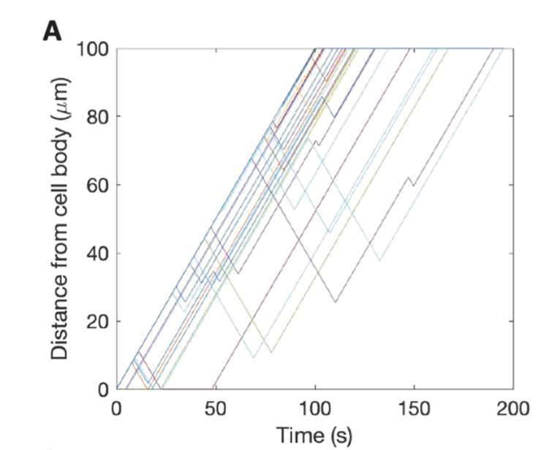
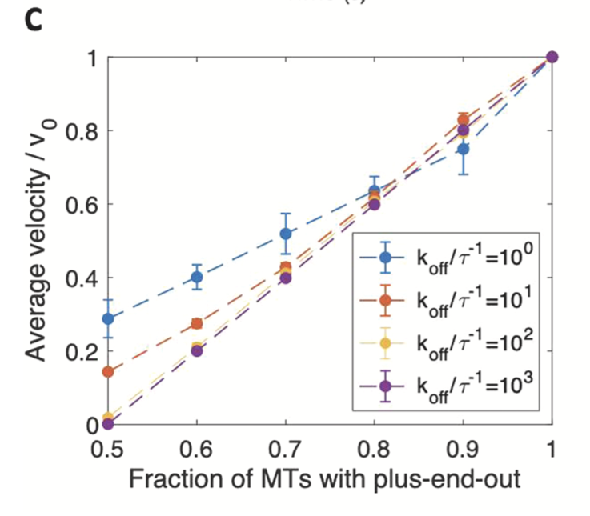
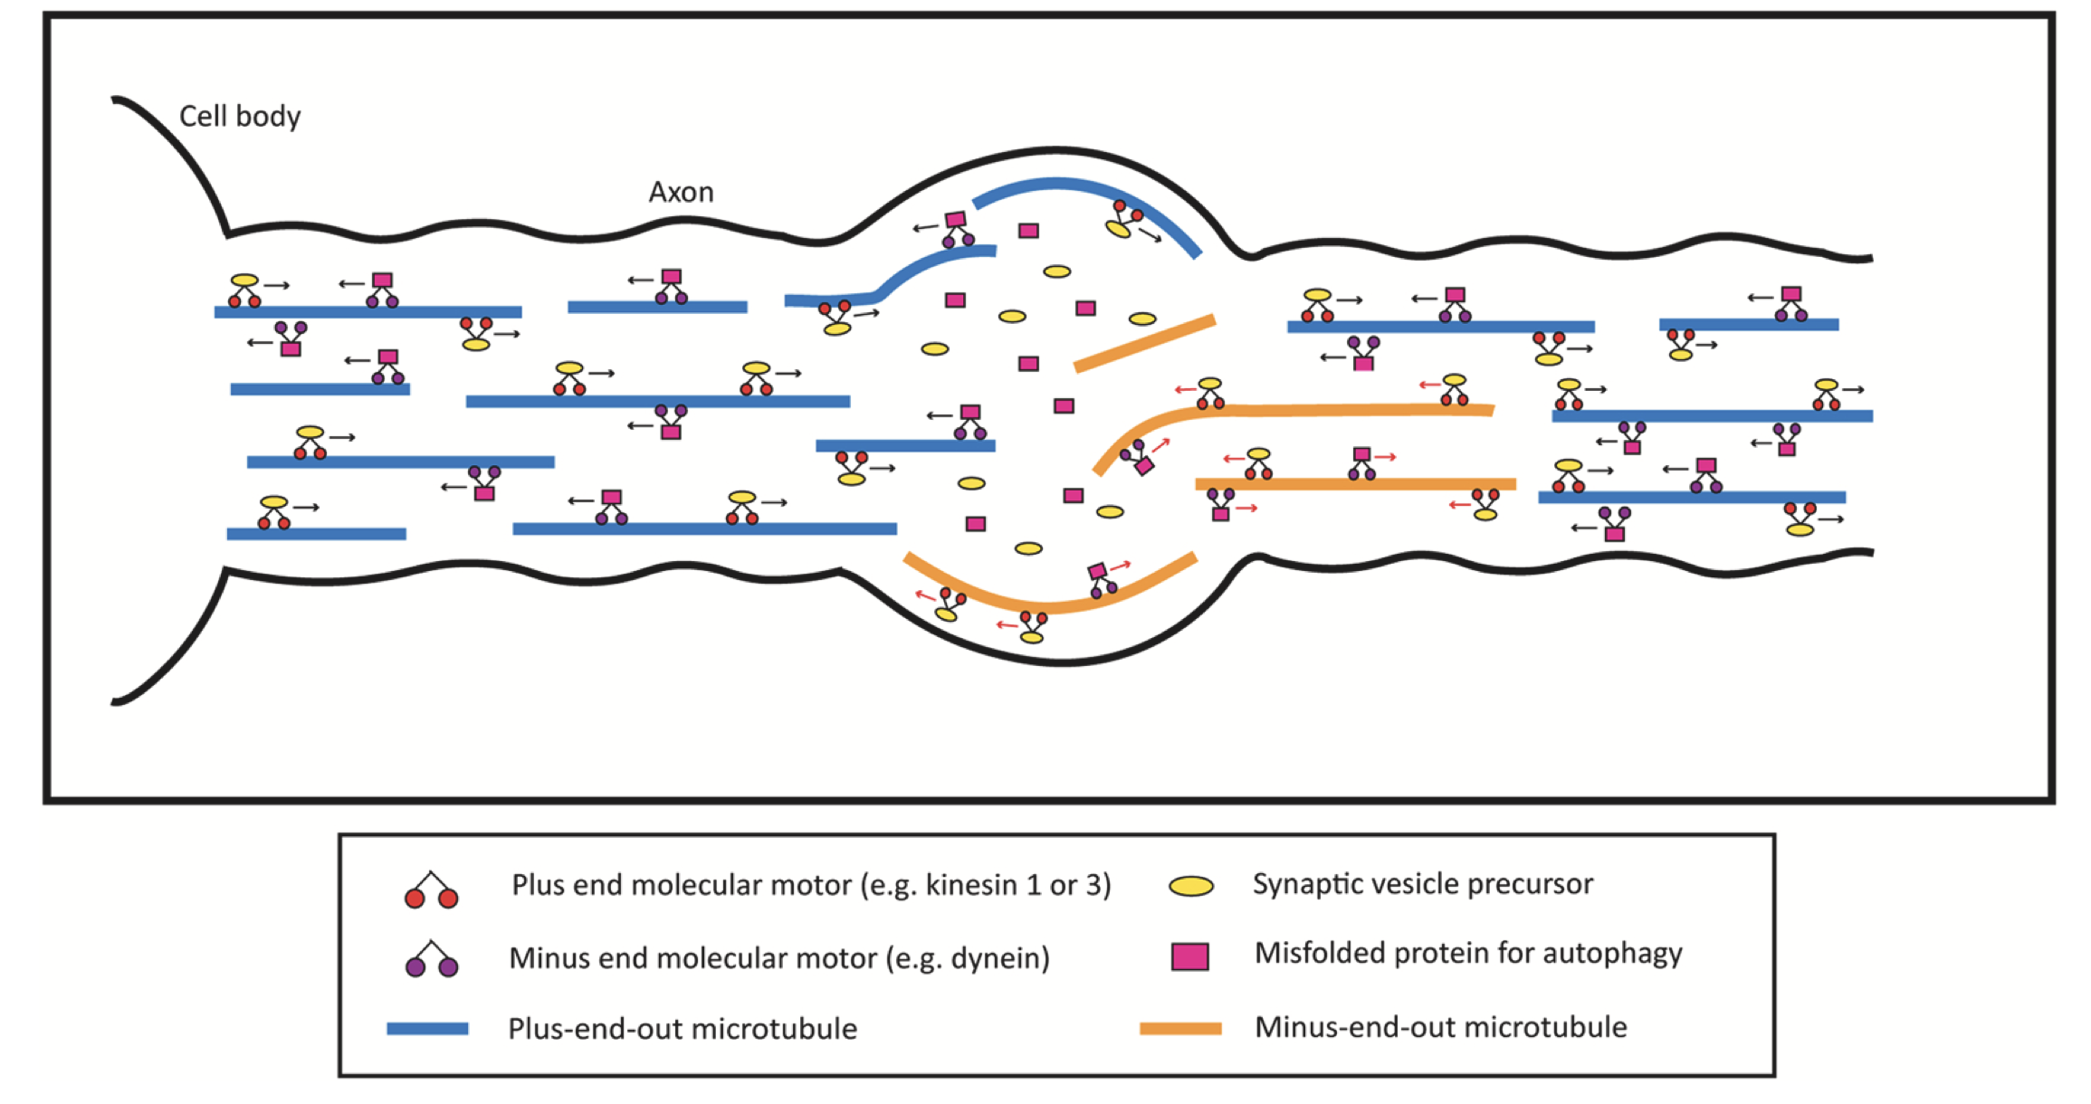
Biophysical Model on the Role of Motor Proteins in Axonal Neurodegeneration Roy Cruz Jr¹, Bridie Eckel², Peter W. Baas², and Erin M. Craig¹ 1. Dept. Physics, Central Washington University, Ellensburg, WA, 2. Dept. Neurobiology./Anat., Drexel University, Philadelphia, PA
Figure 4:
Background
Disruption of axonal microtubule (MT) arrays is a key factor in nerve degeneration associated with neurodegenerative diseases such as Alzheimer’s. In developing axons, nearly all MTs are oriented with their plus ends away from the cell body, referred to as a “plus-end-out” polarity pattern.
Simulation of Motor Protein (MP) Traffic Through The Axon
MT Polarity flaws induce “traffic jams” between MPs
Sample trajectory: polarity flaw in central axon with 10 MT’s
Sample trajectory: polarity flaw in central axon with 100 MT’s
Figure 4: MP movement through the axon and traffic jam between MPs.
Figure 1: Axon schematic
We developed an agent-based simulation model in Matlab that simulates the movement of individual MPs along MTs within an axon. MPs move in a preferred direction along a MT until (1) they stochastically detach and reattach to another MT; or (2) they reach the end of a MT; or (3) they encounter another MP and experience a “traffic jam” causing one of the MPs to detach.
This uniform polarity pattern is under continual threat of corruption in the face of nucleation of new MTs and “flipping” of short MTs into a minus-end-out orientation.
Agent-based simulation tunable features
Number of MT’s and MP’s in the axon
Distribution of retrograde and anterograde MTs
Rate of detaching/reattaching to a new MT
Region of axon with flaws polarity distribution (as in figure 3).
Figure 6: Simulations of interacting MPs demonstrate that “traffic jams” emerge in regions of flawed MT polarity pattern, interfering with transport mechanisms needed for a healthy axon.
MP transport sensitive to MT polarity pattern
Figure 2: Theoretical sources of polarity flaws.
Table 6: Summary of simulated data for axons with different numbers of MPs
Objective: Computational investigation of how motor protein (MP) transport is impacted by MT polarity flaws
Next steps:
Experimental test of model predictions.
Related study: Rao et al., 2017.
Add dynein motor protein to the model.
Related study:
Eckel et al., 2022.
Figure 5: Simulations of non-interacting MPs to investigate dependence on MT pattern. Adapted from Eckel et al, 2022.
References:
Rao, A.N. and Baas, P.W. (2017), Polarity Sorting of Microtubules in the Axon, Trends in Neuroscience, 41(2):77-88.
Craig et al. (2017), Polarity sorting of axonal microtubules: a computational study, Mol. Biol. Cell, 28(23):3271–3285.
Rao et al. (2017), Cytoplasmic dynein transports axonal microtubules in a polarity-sorting manner, Cell Reports, 19:2210-2219.
Eckel et al. (2022). Microtubule polarity flaws as a treatable driver of neurodegeneration., Brain Research Bulletin, 192:208-215.
Work for this project was supported by NSF Research at Undergraduate Institutions Award 1915477 and a grant from the US Dept. of Ed/McNair Scholars Program.
Flaws in the microtubule (MT) polarity pattern throughout the axon lead to reduced average velocity of motor proteins (MPs), because MPs move in the “wrong” direction when attached to a minus-end-out MT.
Motor proteins with high processivity (i.e., that walk long distances before detaching (purple data points) are the most strongly affected by MT polarity flaws.
Figure 3: Schematic of microtubule polarity distribution, and motor protein transport along microtubules. Adapted from Eckel et al, 2022.

